Slide 1
Smart Buy
Buy everything you need in a smart way

Slide 2
Team member
Supervisor: Mr. Kiều Trọng Khánh
Đoàn Hồ Anh Triết
Đặng Hữu Hoàng
Trần Trung Dũng
Huỳnh Thanh Việt (Dropped out)

Slide 3
Outline
Scenario problem
Our solution
Demonstration
Advantages and disadvantages of current solution
Questions and answers

Slide 4
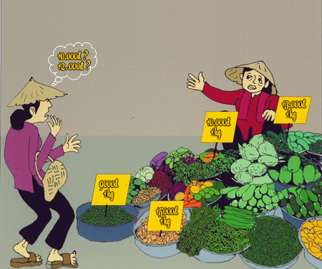
Scenario Problem

Slide 5
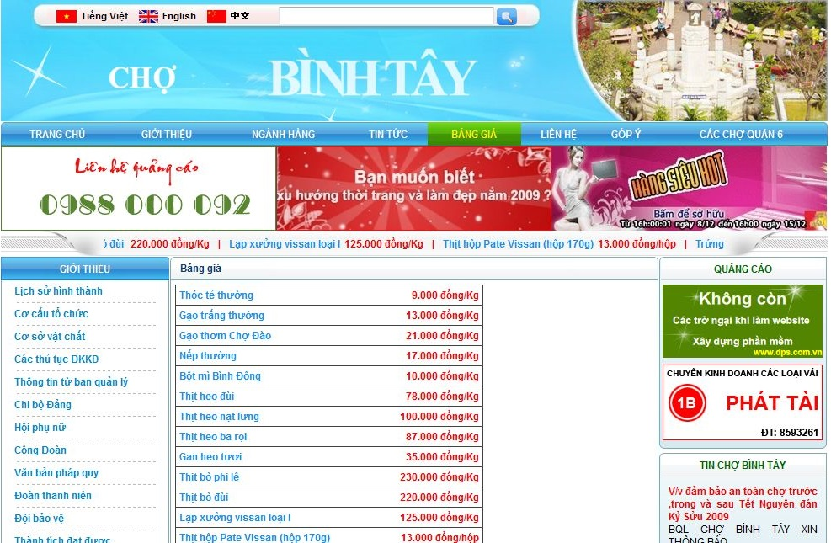
Scenario Problem

Slide 6
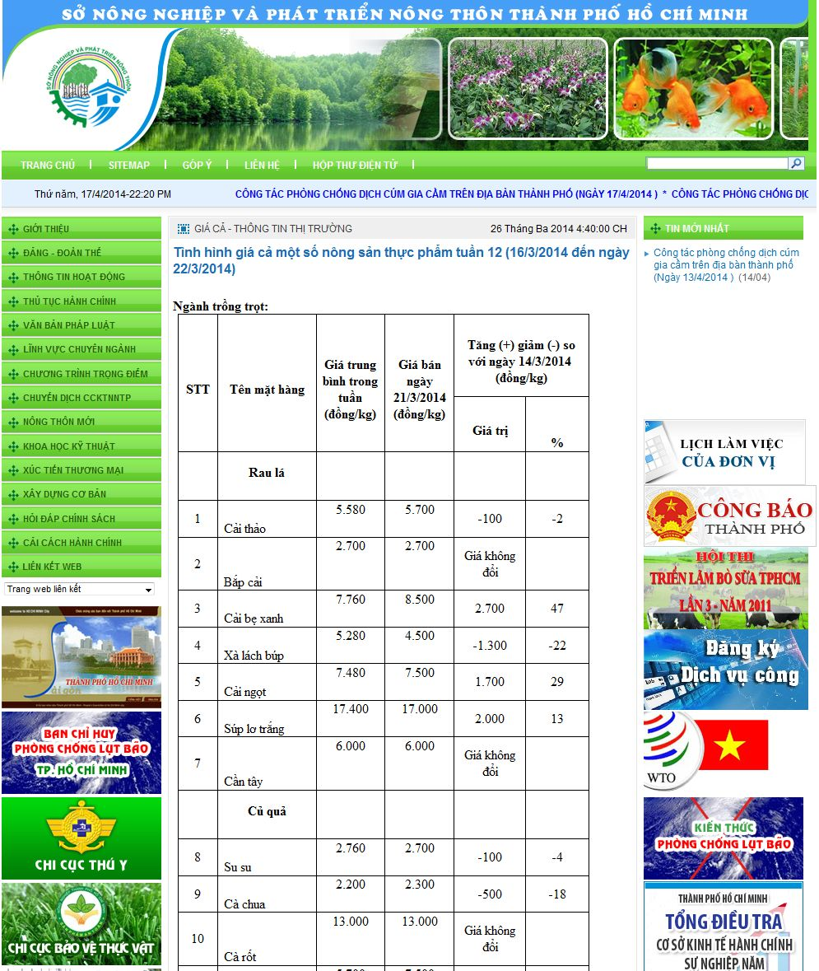
Scenario Problem

Slide 7
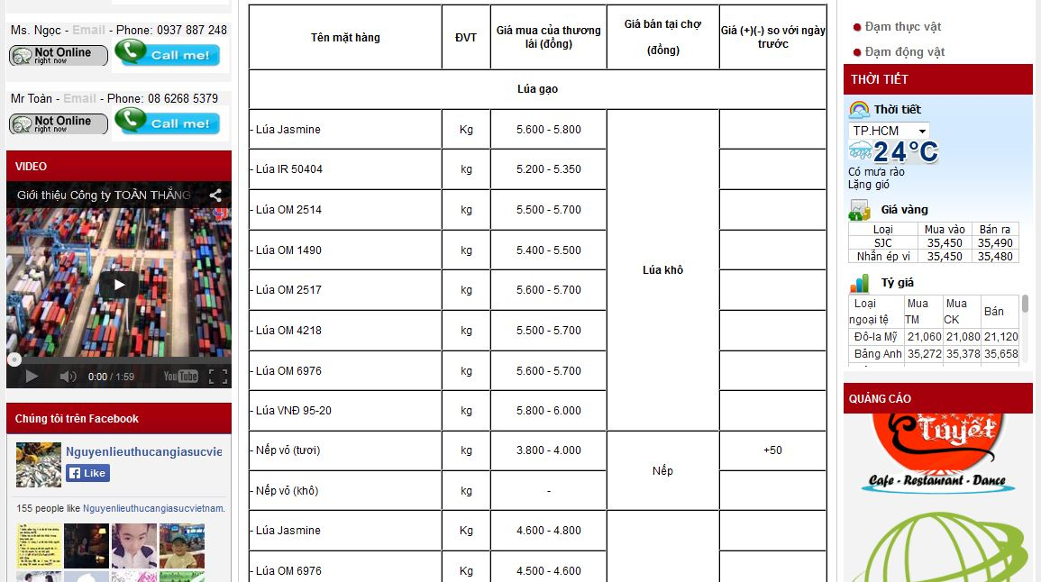
Scenario Problem

Slide 8
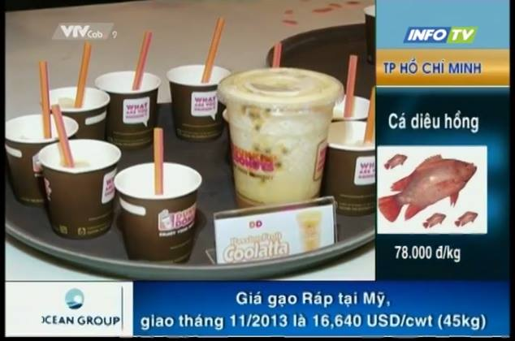
Scenario Problem

Slide 9
Our Ideas
Collect data
Build structure
Public to end user

Slide 10

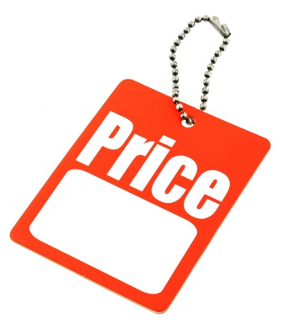

Our Solution
Track
Give
System
Price
Suggestion

Slide 11
Features
Search
Propose price
Manage cart
Suggestion
Import Excel
Get data from web
Mobile device

Slide 12




Demonstration Story

Slide 13
Story Board
1 guest.
1 member.
1 staff.

Slide 14




Demo Scenario - Guest
Search product
Add to cart.
View cart
View list

Slide 15


Demo Scenario - Member
Define Routes
Ask for suggestion

Slide 16
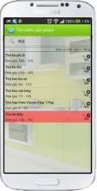


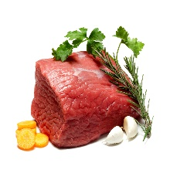








Mobile Member
1.1
Guest
1.2
1.3
2.3
2.6
2.4
2.2
2.5
2.1
Member

Slide 17

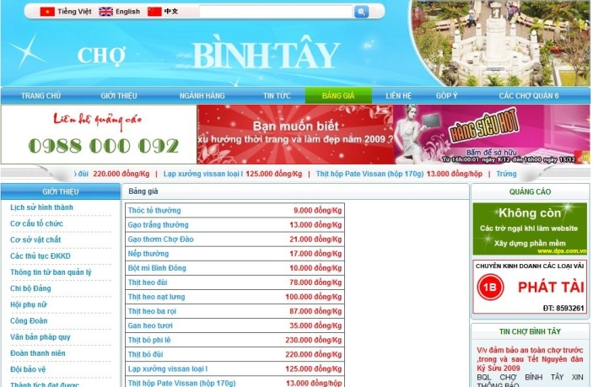


Data Source

Slide 18


Demo Scenario - Staff
Import data
Train machine
Manage parsers

Slide 19
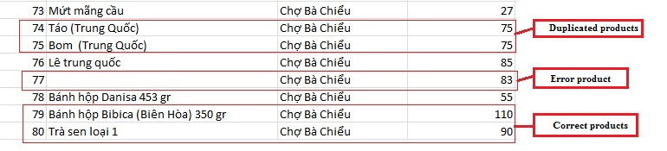
Terminology
Duplicate
Error
Correct
Merge (gộp): make two or more names refer to one product.
Split (tách): different names mean different products.

Slide 20
Import Excel Flow
EXCEL FILE
1
2
3
Correct Products List
Error Products List
Duplicate Products List

Slide 21
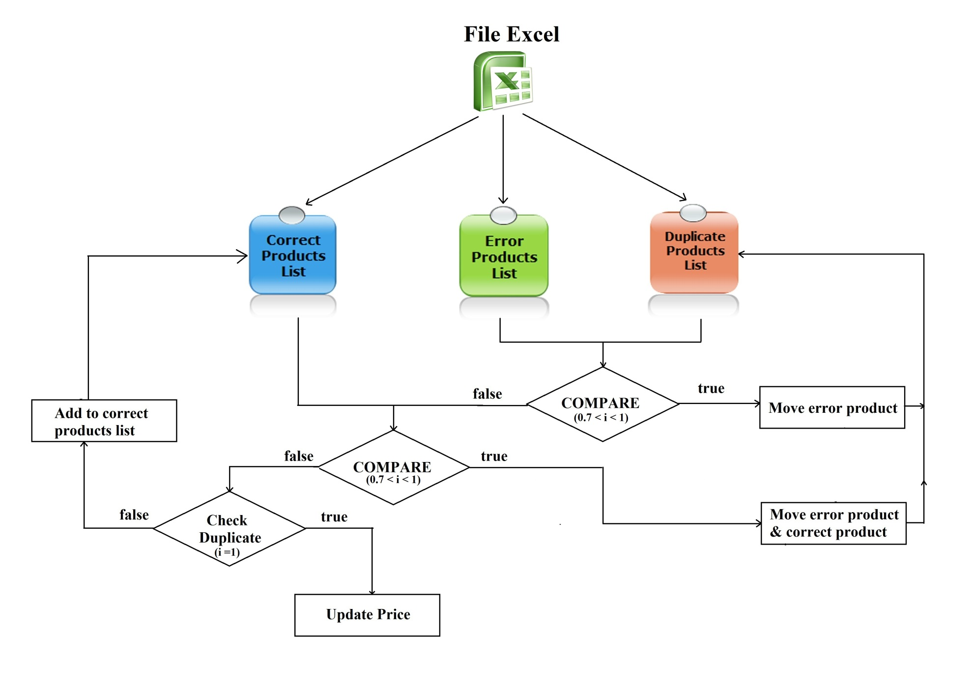
Import Excel Flow

Slide 22
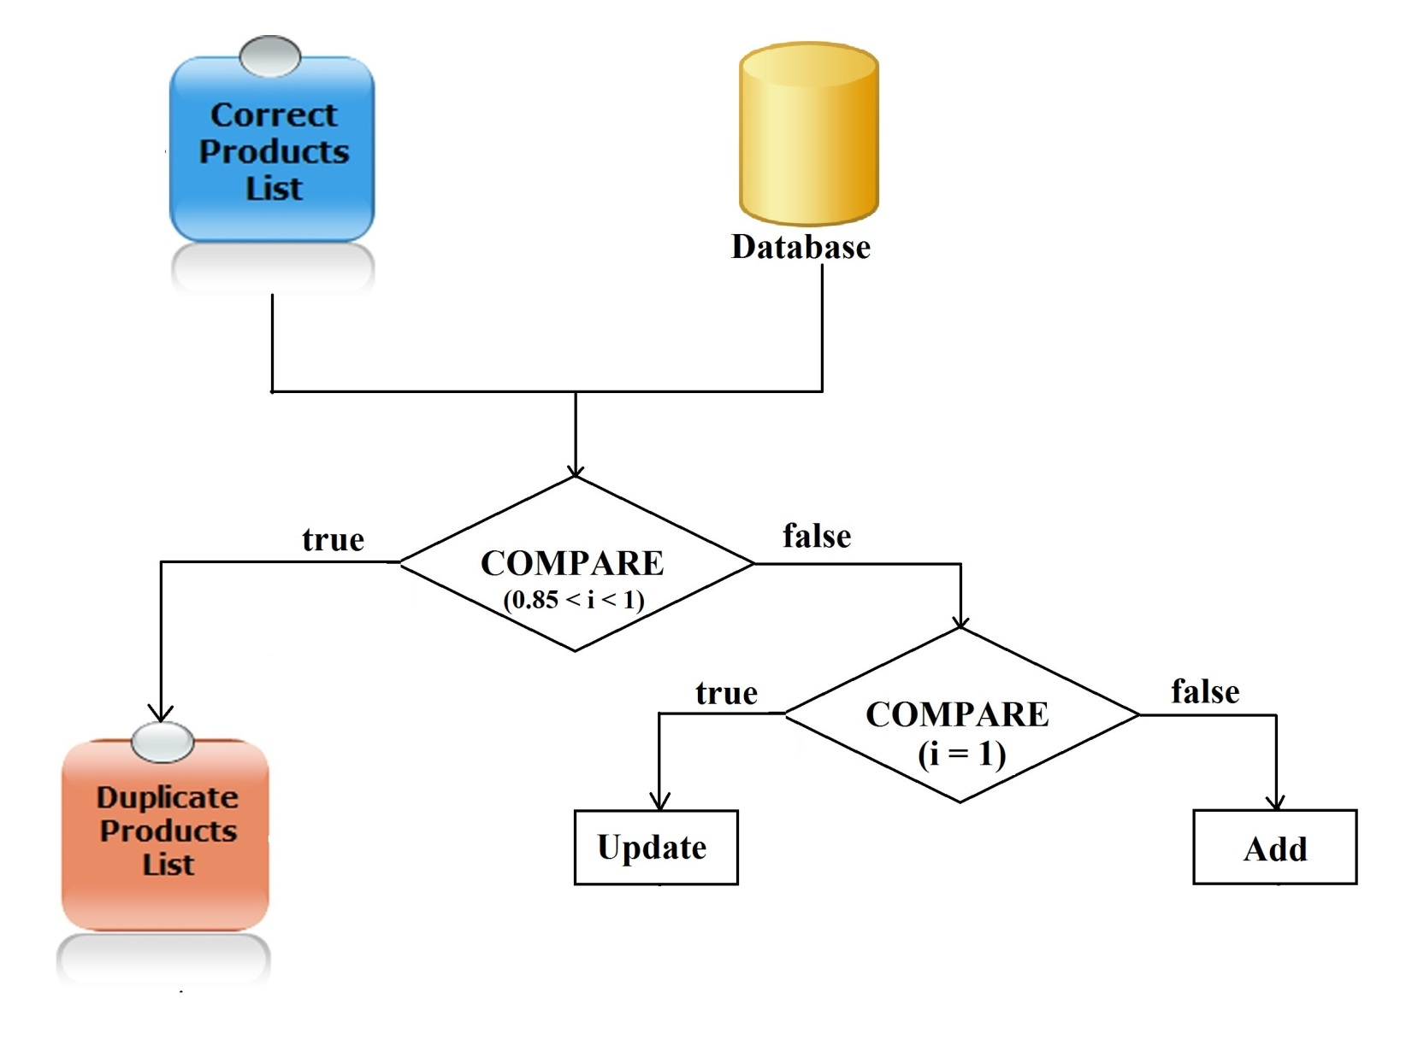
Import Excel Flow

Slide 23
Excel Flow
Step 1: Import Excel.
Step 2: Process error products & duplicate products.
Step 3: Save correct products to database.
Step 4: Process duplicate products with database.

Slide 24
Data mining from websites
Get link
Inspect

Slide 25




Smart Buy System
1.1
1.4
Guest
1.2
1.3
2.3
2.6
2.4
2.2
2.5
2.1
Member

Slide 26



Slide 27
Future Plan

Slide 28
THANK YOU FOR YOUR ATTENTION! Q & A

